Slide 1
Fundamentals of Business Lesson 4:Vision, Mission, Goals & Objectives
Instructor: P Pavalaxan
April 2024

Slide 2

Learning objectives
Management – Definitions
Effectiveness and efficiency
Managerial Functions
Process of management
Administration and Management

Slide 3

What is Management
Management is the process of getting things done, effectively and efficiently, through and with other people

Slide 4
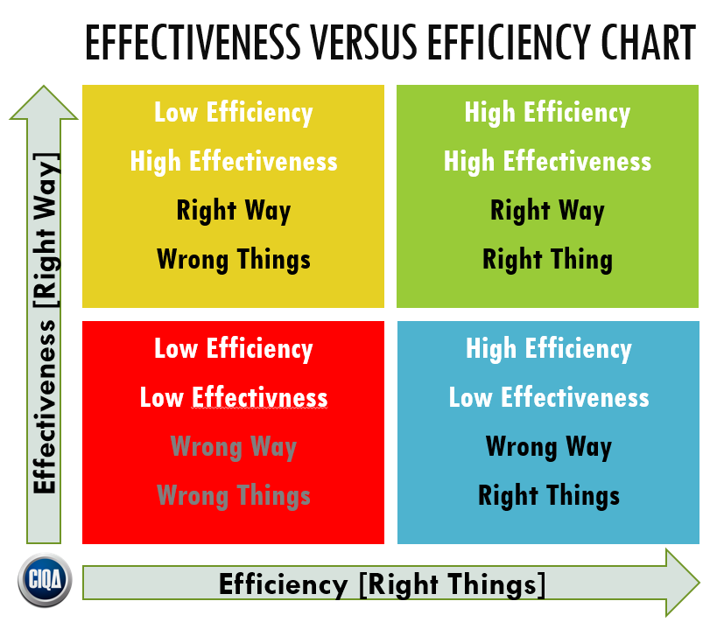
What is Management
Effectiveness means doing the right things; Goal Attainment
Efficiency means doing things correctly; refers to the relationship between inputs and outputs; Seeks to minimise the resource and cost.

Slide 5
Definition of Management
F.W. Taylor - “Management is an art of knowing what is to be done and selling that it is done in the best possible manner.”
Mary Parker Follet -“Management is the art of getting of things through people.”
Harold Koontz - “Management is art of getting things done through and with the people in formally organised groups”.
Henry Fayol - Management is “To manage is to forecast and to plan, to organise, to command, to co-ordinate and to control.”
George R Terry- “Management is a distinct process consisting of planning, organising, actuating and controlling performance to determine and accomplish the objectives by use of people and resources”

Slide 6
Definition of Management
Management is not just getting things done through others. It is getting things done through others by satisfying their needs and providing them with the opportunities for growth and advancement.
It is the process for the utilisation of minimum input for the production of maximum output
Management is defined in terms of functions undertaken by the manager to achieve organisational goals.
Management is the systematic way of doing things.

Slide 7
Importance of Management
Achievements of group goals
Optimum utilization of resources
Minimisation of cost and Higher profits
Change and growth
Provide innovation
Effective functioning of business
Social benefits
Sound organization structure
A tool for personality development
Useful for developing countries

Slide 8
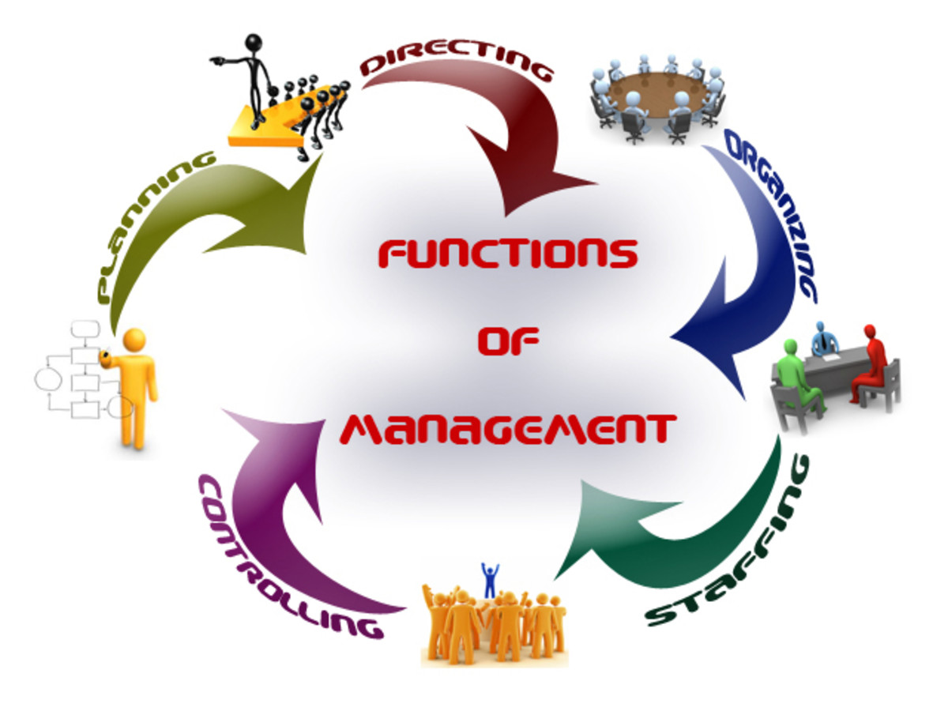
Managerial Functions

Slide 9
Planning: Definition
KOONTZ, “Planning is deciding in advance - what to do, when to do & how to do. It bridges the gap from where we are & where we want to be”.
It is the basic function of management
It is determination of courses of action to achieve desired goals.
It is a systematic thinking about ways & means for accomplishment of pre-determined goals.
It is necessary to ensure proper utilization of human & non-human resources.

Slide 10
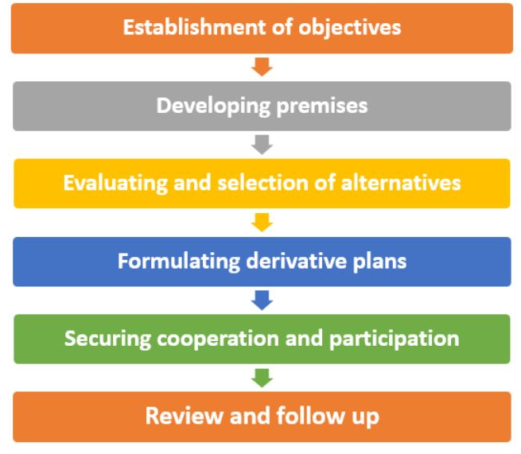
Planning: process

Slide 11
Organising: Definition
Henry Fayol, “To organize a business is to provide it with everything useful or its functioning i.e. raw material, tools, capital and personnel’s”
It is the process of bringing together physical, financial and human resources and developing productive relationship amongst them for achievement of organizational goals
It involves determining & providing human and non-human resources to the organizational structure.

Slide 12
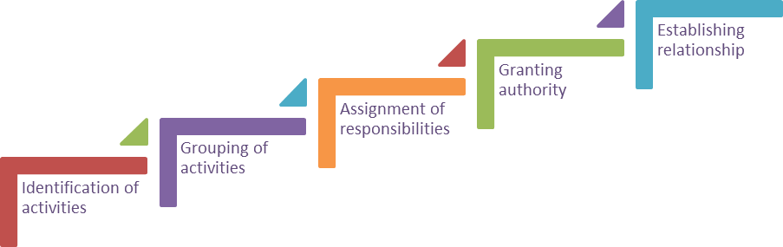
Organising: Process

Slide 13
Staffing: Definition
Kootz & O’Donell, “Managerial function of staffing involves manning the organization structure through proper and effective selection, appraisal & development of personnel to fill the roles designed un the structure”.
It is the function of manning the organization structure and keeping it manned.
The main purpose o staffing is to place right person on right job
Training & Development.
Remuneration.
Performance Appraisal.
Promotions & Transfer.

Slide 14
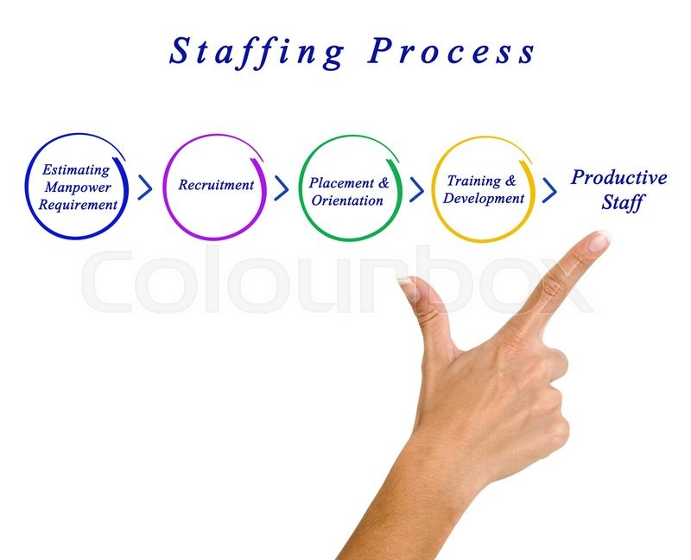
Staffing: Process
Promotions & Transfer < Performance Appraisal < Remuneration

Slide 15
Directing/Leading: Definition
The management function that involves the manger’s efforts to stimulate high performance by employees.
Leading involves influencing others through direction, inspiration, and motivation toward the attainment of organizational objectives.

Slide 16
Directing: Elements
Supervision- implies overseeing the work of subordinates by their superiors. It is the act of watching & directing work & workers.
Motivation- means inspiring, stimulating or encouraging the sub-ordinates with zeal to work. Positive, negative, monetary, non-monetary incentives may be used for this purpose.
Leadership- may be defined as a process by which manager guides and influences the work of subordinates in desired direction.
Communications- is the process of passing information, experience, opinion etc from one person to another. It is a bridge of understanding.

Slide 17
Controlling: Definition
Haimann, “Controlling is the process of checking whether or not proper progress is being made towards the objectives and goals and acting if necessary, to correct any deviation”
Koontz & O’Donell “Controlling is the measurement & correction of performance activities of subordinates in order to make sure that the enterprise objectives and plans desired to obtain them as being accomplished”

Slide 18
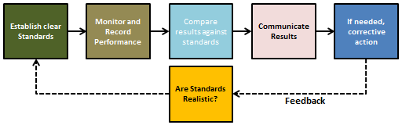
Controlling: Process

Slide 19
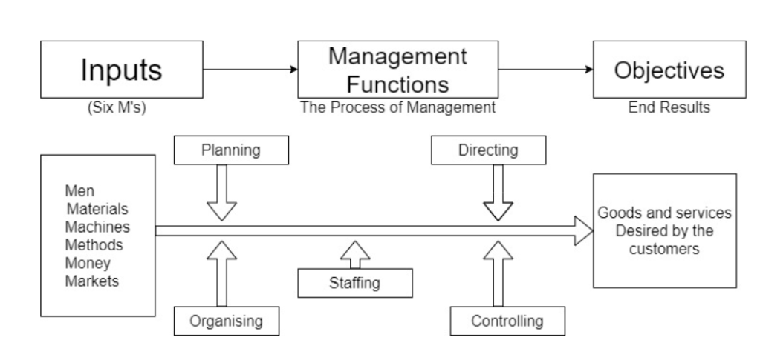
Process of Management

Slide 20
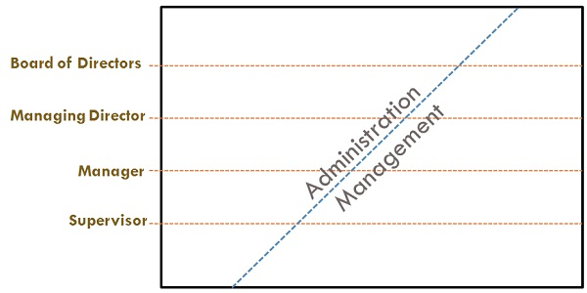
Administration and Management
Management is an art of getting things done through others by directing their efforts towards achievement of predetermined goals.
Administration is concerned with formulation of broad objectives, plans & policies.

Slide 21
Administration and Management
Basis | Management | Administration
Nature | Management is an executing function. | Administration is a decision-making function.
Process | Management decides who and How it should be done | The administration decides what is to be done & when it is to be done.
Function | Management is a doing function because managers get work done under their supervision. | Administration is a thinking function because plans & policies are determined under it.
Skills | Technical and Human skills | Conceptual and Human skills
Level | Middle & lower level function | Top level function

